Slide 1
Last Week
Create power point for zoom call with Tim and Ally
Have pictures so we can fully visualize the issues
Have videos end at full deformation
Clearly show 2,3,4 chamber designs at the same size(front, side, and isometric view)
Chart that shows still images of deformation vs solidworks results
Practicalities(model construction, is it us?)
In your printing of this, what did you learn that you would like us to incorporate in this?
Create Pressurizing rig
Build pressurizing table with 5mm 2 chamber model
Build helix to 3 revolutions make it thinner to exaggerate displacement
Why is there displacement at the fixed point
Order Parts when we hear from Sherri
Organize DIMLab folder

Slide 2
5mm 2 Chamber Deformation Chart
(x,y) disp. (mm) | C1 0 psi | C1 5 psi | C1 10 psi | C1 15 psi | C1 20 psi
C2 0 | (0, 0)
C2 5 psi | (2.637, -3.011) | (0, -5.986)
C2 10 psi | (4.794, -6.099) | (2.461, -9.117) | (0, -11.56)
C2 15 psi | (7.282, -9.271) | (4.931, -12.35) | (2.551, -15.62) | (0, -17.79)
C2 20 psi | (9.835, -12.51) | (7.468, -15.68) | (5.065, -19.02) | (2.633, -22.44) | (0, -24.28)
C1-10 C2-20 failed at 72.8%
C1-15 C2-20 failed at 70.2%
C1-20 C2-20 failed at 70.2%

Slide 3
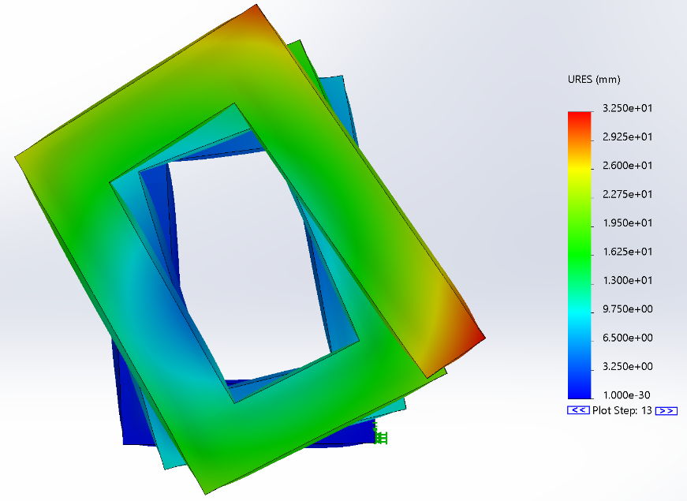
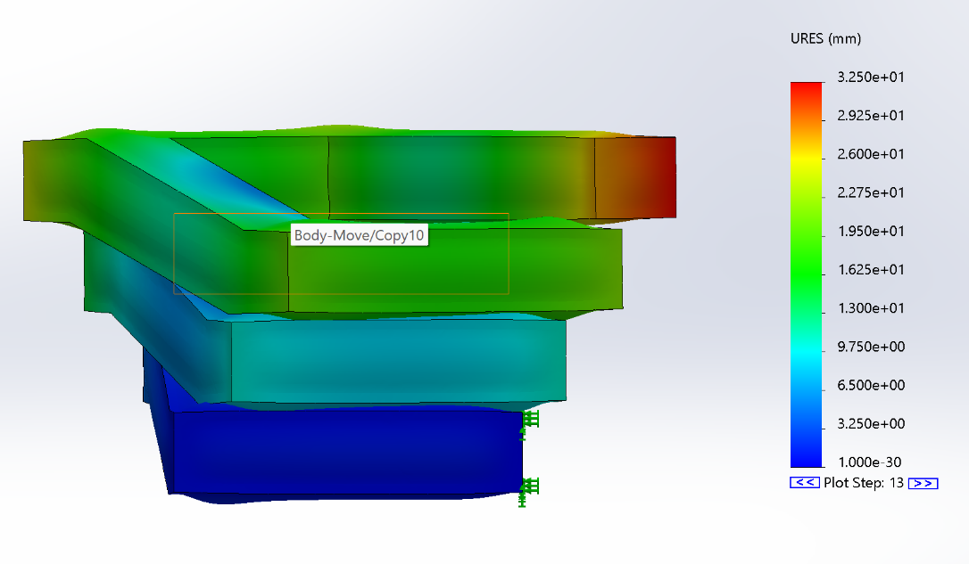
Square Helix Design
2mm wall thickness but same dimmensions as last week otherwise

Slide 4
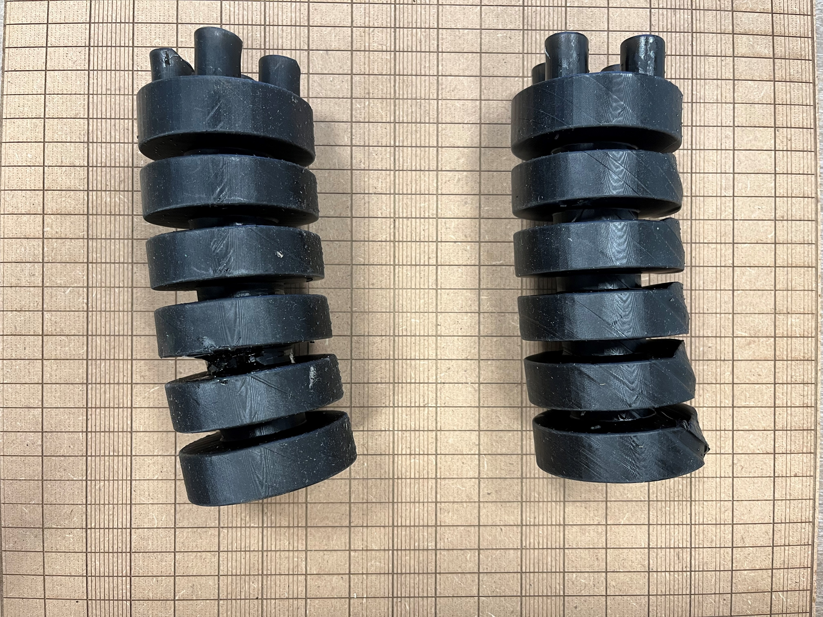
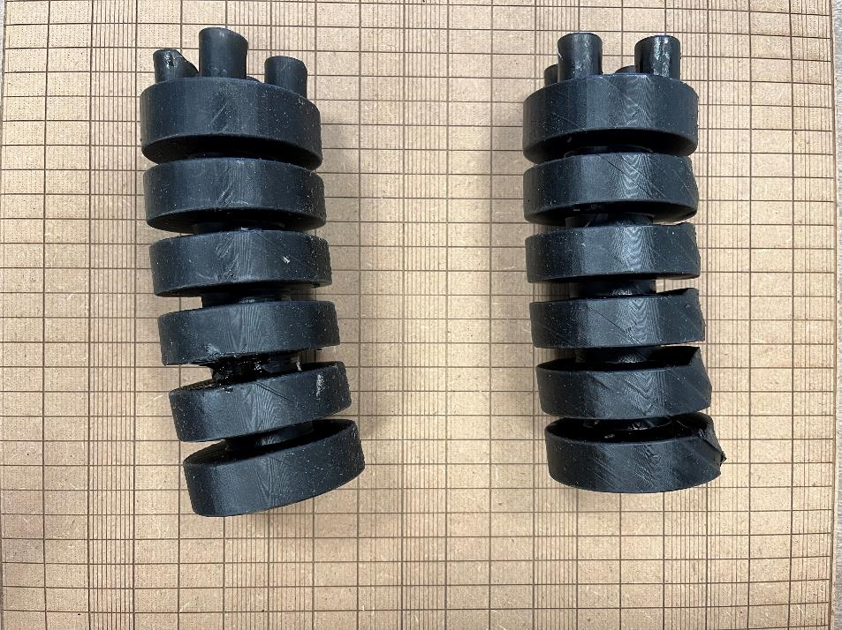
Printing Issues

Slide 5
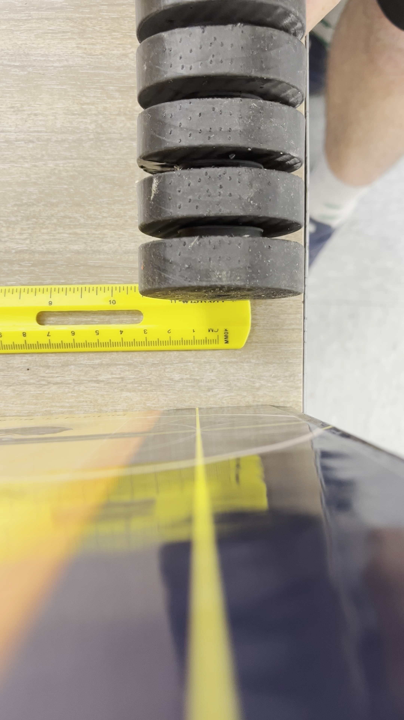
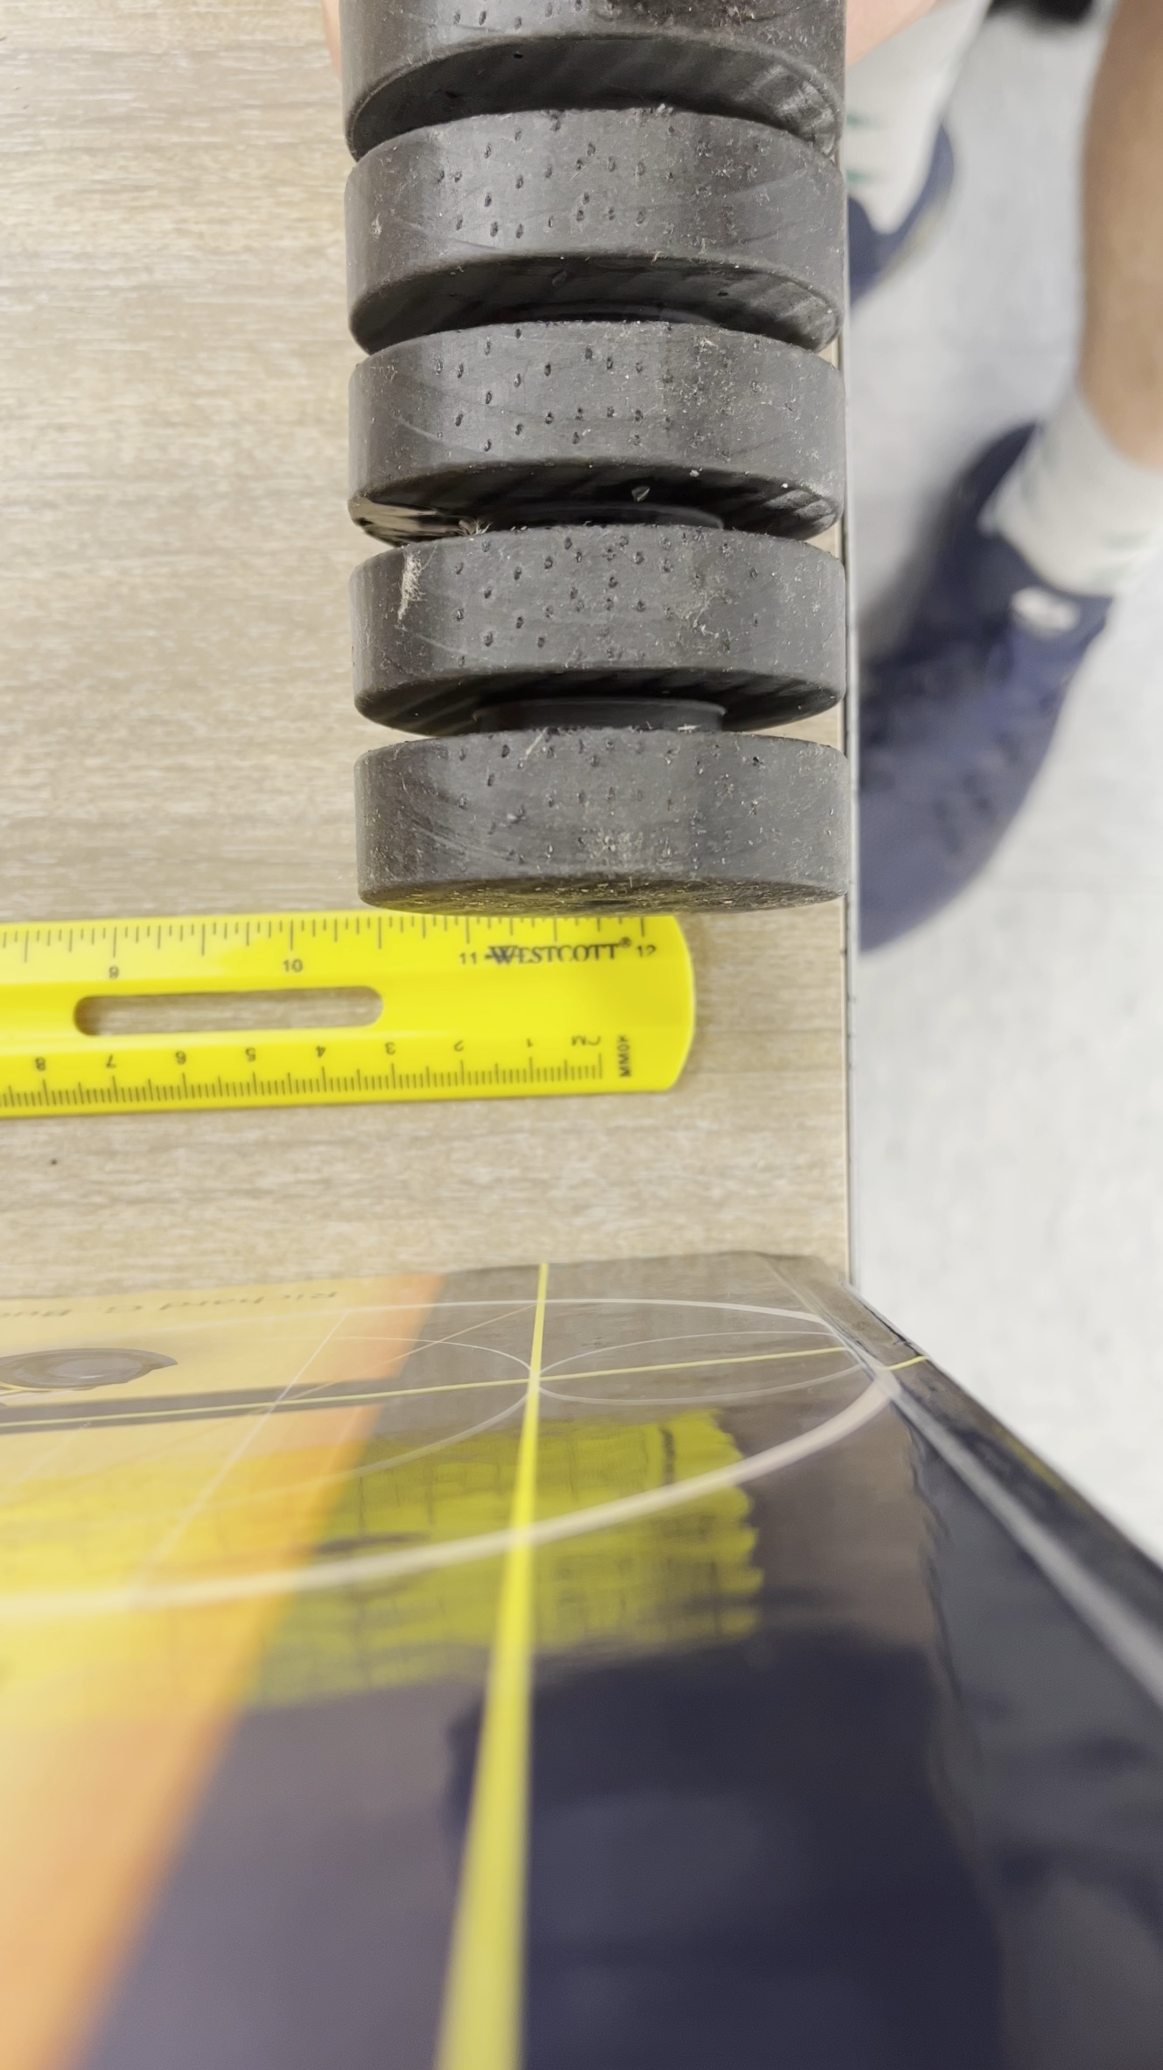
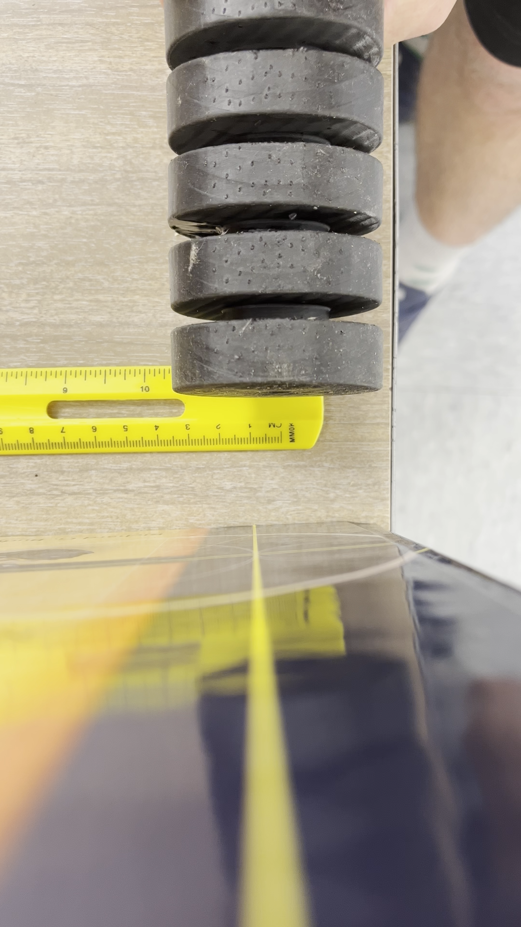
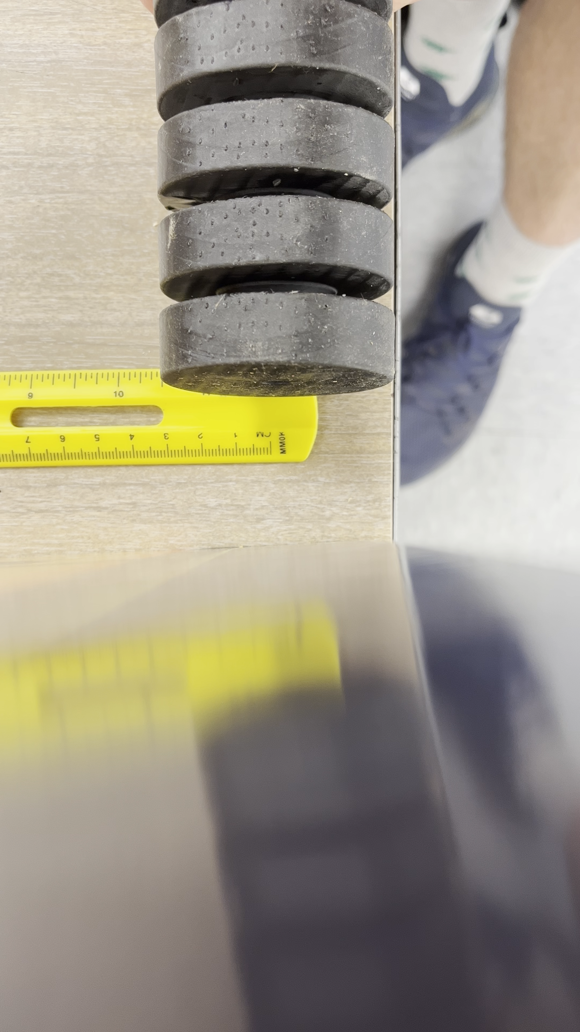
Testing One Chamber
5 psi
10 psi
15 psi
20 psi

Slide 6
For Next Week
Make PowerPoint For Friday
Get more pictures of bad prints
What Questions need to come up?
What can we do for the next print? What can they do for the next print? Questions like this need to come up
Build Testing Rig after part delivery
Hopefully meeting leads to work (Fri 9:15am)
Helix with offset chamber and more space between layers
Hexagonal/Octagonal helix
Review assembling and animating a 4 bar mechanism connected by revolute or prismatic joints

